Slide 1

Tour and Travel Tribe
Group No.02
Under The Supervision of:-
Mrs. Sonika Bharadwaj
(Asst. Professor)
Department of CEA
GLA University, Mathura
Presented By:-
Sanjay Chahar(2384200184)
Sumit Singh (2384200215)
Vishnu Rajput(2384200249)
Ashish Kumar(2384200039
Dhruv Pandey(2384200062)
&TEAM

Slide 2
Content
Introduction
Purpose
Objective
Hardware And Software Requirement
Project Scope
Tools and Technology
REQUIREMENT ANALYSIS
UML SYSTEM DESIGN
Conclusion
References

Slide 3

Introduction
Tour and Travel Tribe is a software-based Project/Application in java.
The main purpose of this project is How to manage the booking of hotels, packages and check sites
It makes all operations of the tourist easy and accurate

Slide 4
Purpose
The main purpose of this project is to manage the booking of hotels, packages and check sites
This application will help to accessing the information related to the travel.
The users can track the information related to their tours.
The travel agency information can also be obtained through this application.
Users don't have to visit to the office for bill payment.

Slide 5
Objective
We, the owners of our project, respect all customers and make them happy with our service. The main aim of our project is to satisfy customer by saving their time by payment process, maintaining records, and allowing the customer to view his/her records and permitting them to update their details
.
.

Slide 6
Project Scope
We want to improved our home page, as it is the main thing which attracts all user.
We want to provide more facilities as per the user requirements.
Not a single website is completed forever firstly because there is always something new requirements day by day

Slide 7
Requirement gathering Analysis 1.Requirement Report
Tour and Travel Tribe is a software-based application/project in java application.
The main purpose of this project is how to manage the booking of hotels ,packages and check the sites.
It makes all operations of the tourist is easy and accurate.
User Management
(A) Login
(B) User Profile
(c) Update Information
(D) Role based rights

Slide 8
Administrator Module:
The main Purpose of this module is to add the route information, bus information, train information, train information, flite information, tour packages, travel packages, bus seat details etc.
(A) manage user information
(B) update information
(C) Manage Trips
(D) Manage hotels, Bookings
HOTEL MODULE:- in this module we provide accommodation for customers during their Tours.
(A) Registration (AS User)
(B) REGISTRATION (AS Hotel)
(c) Search

Slide 9
Transportation Module
Flight
Train
Bus
Package Module – in this package module users can view different tour packages for tourist.
Payment Module:- in this module tourists can pay payment through online banking etc.
Route Module:- Route module provides the path/route information and exact location for tourists.

Slide 10
Hardware And Software Specification
Hardware :-
Hardware Requirements:
Hardware Specification: -Processor Intel Pentium V or higher
Clock Speed: -1.7 GHz or more
System Bus: -64 bits
RAM: -4GB
HDD: -512 SSD
Monitor: -LCD Monitor
Keyboard: -Standard keyboard
Mouse: -Compatible mouse
Software Requirements:
Operating System: -Windows 10,11
Software: -Microsoft SQL Server
Front End: -Java core/swings (NetBeans)
Back End: -My SQL

Slide 11
SYSTEM DESIGN 1.1 Preliminary Design
System design is the process of defining the elements of a system such as the architecture, modules and components, the different interfaces of those components and the data that goes through that system.
System designing in terms of software engineering has its own value and importance in the system development process as a whole

Slide 12
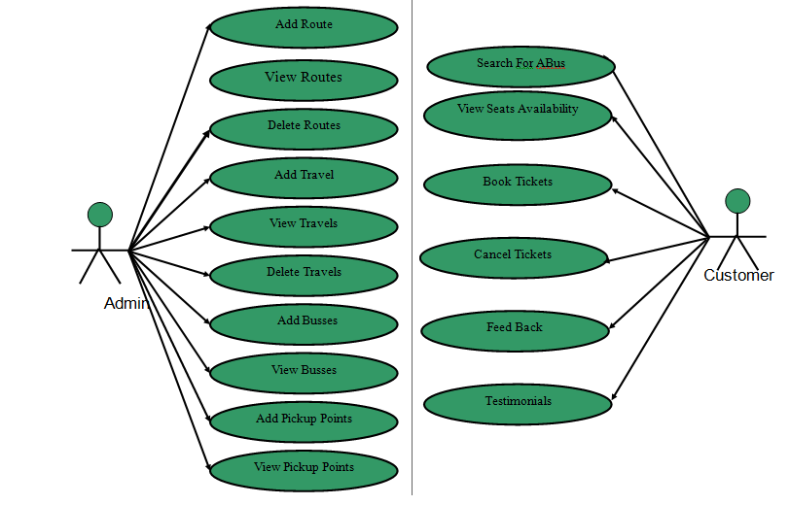
1.1(A) UML Diagram Use Case Diagrams: it is used for design the behaviour of a system. Actor/Relation /Generalizition/system use case.

Slide 13
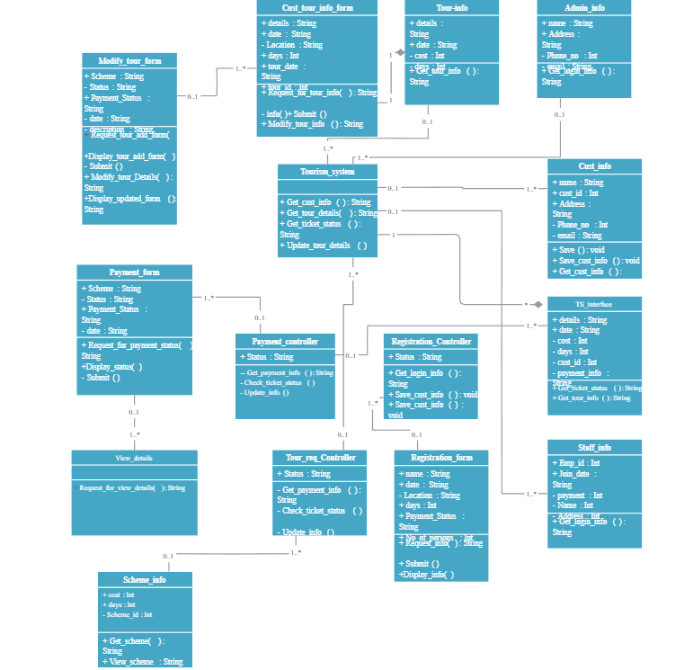
Class Diagram: 1.structure-based diagram/ should various components for project.

Slide 14
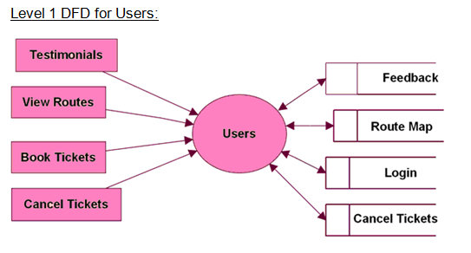
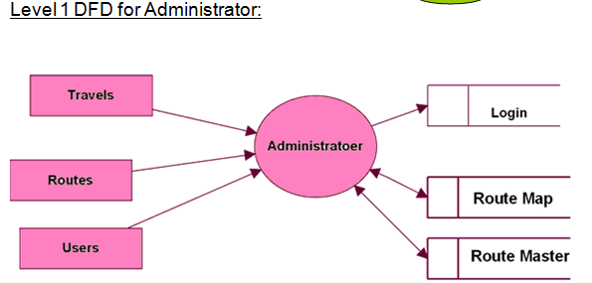
DFD: 1. Users can share their experience and for that they can give their feedback. 2. users can book the tickets and for that they have to passes a Login process. 3.process , source of sink , data store etc.

Slide 15
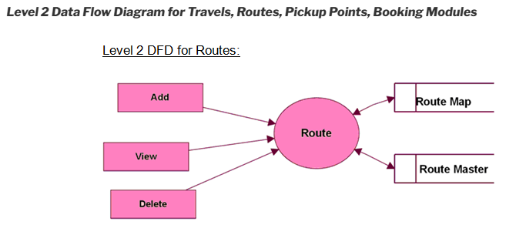
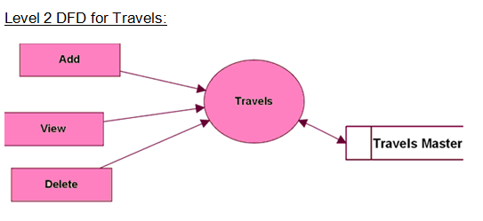
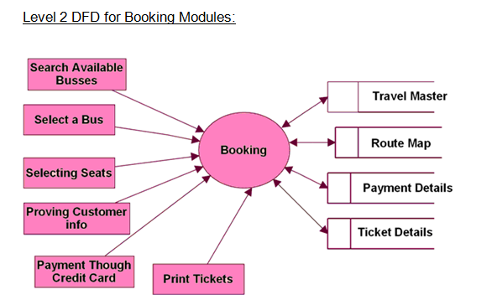

Slide 16
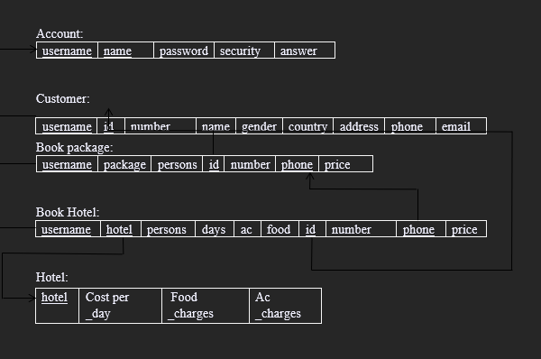
1.2 SCHEMA DIAGRAM: 1.Schema describes the logical view of entire data-base and it looks like skeleton of the database. A database schema is the skeleton structure that represents the logical view of the entire database. It defines how the data is organized and how the relations among them are associated.

Slide 17
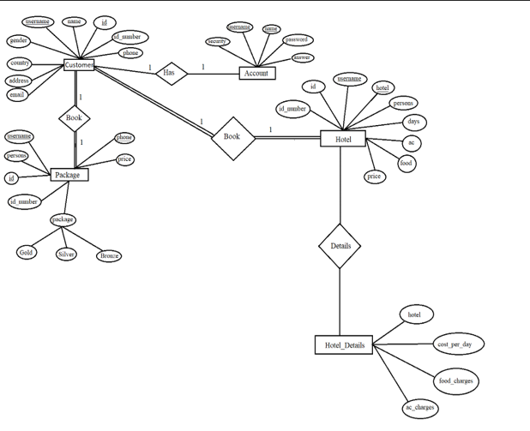
1.3 E R DIAGRAM: ER Diagram stands for Entity Relationship Diagram, also known as ERD is a diagram that displays the relationship of entity sets stored in a database. In other words, ER diagrams help to explain the logical structure of databases. ER diagrams are created based on three basic concepts: entities, attributes and relationships.

Slide 18
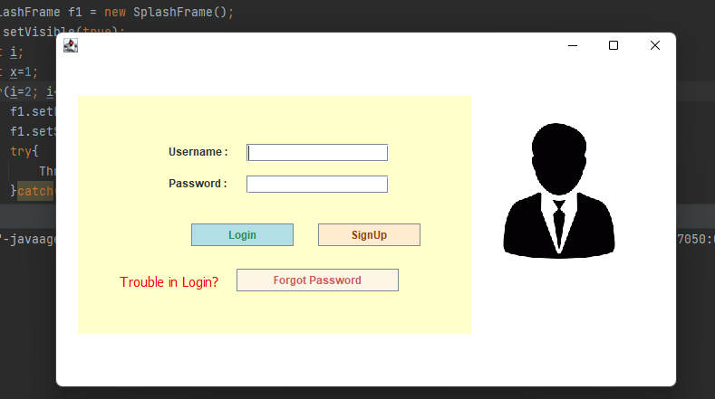
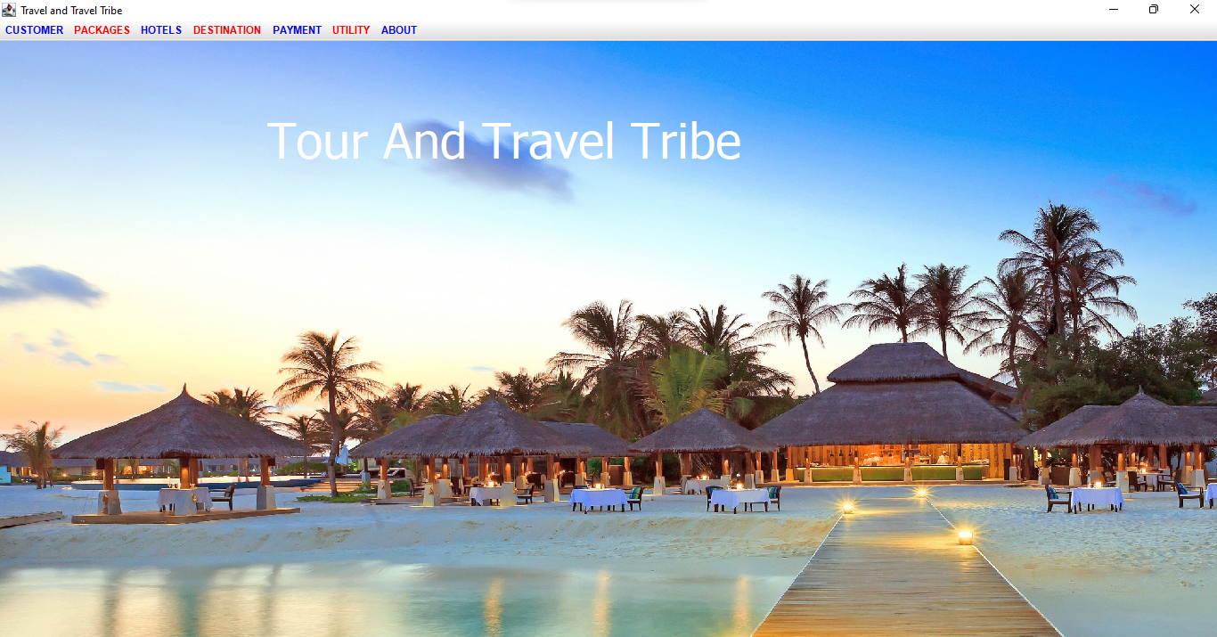
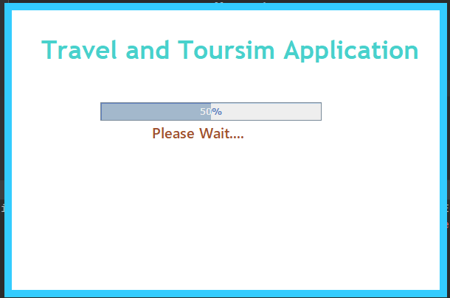

Slide 19
Conclusion
After all the hard work is done for TTT is here. It is a software which helps the user to work with the adding hotels, paying bills, managing different DETAILS under which are working etc.
This software reduces the amount of manual data entry and gives greater efficiency. The User Interface of it is very friendly and can be easily used by anyone.
It also decreases the amount of time taken to write details and other modules

Slide 20
References
http://www.github.com
https://www.youtube.com/watch?v=iWitVuW2D1o&t=4s
www.stackoverflow.com
www.google.com
http://www.javatpoint.com/

Slide 21
THANK YOU!!!

